Slide 1
AWS Networking

Slide 2
What is VPC
Amazon Virtual Private Cloud (VPC) enables you to launch AWS resources into a virtual network that you've deﬁned.
A Virtual Private Cloud is a virtual network dedicated to your AWS account.
It is logically isolated from other virtual networks in the AWS cloud.
You can launch your AWS resources, such as Amazon EC2 instances, into your VPC.
You can conﬁgure your VPC; you can select its IP address range, create subnets, and conﬁgure route tables, network gateways, and security settings.
Use a public subnet for resources that must be connected to the Internet, and a private subnet for resources that won't be connected to the Internet.

Slide 3
VPC Features
5
Attach one or more network interfaces to your instances
Assign static private IPv4 addresses to your instances
Assign multiple IP addresses to your instances
Access control lists (ACL)
Run your instances on single-tenant hardware
Egress & Ingress ﬁltering

Slide 4
AWS VPC: Types
6
Default VPC
Non-Default VPC

Slide 5
Default Vs Non-Default VPC’s
7
Characterisitics | Default VPC | Non-Default VPC
Public IP Address | Instance receives Public IP Address by default | Instance does not receive Public IP Address by default
Private IP Address | Instance receives a static IP private address from the range of default VPC | Instance receives a static IP private address from the range of VPC
DNS Hostnames | Are enabled by default | Are disabled by default
Accessing the internet | Instance can access the internet | Instances cannot access the internet
Internet Gateway | It is attached to the default VPC and the default subnet has a route to IGW | Depends on how it was created

Slide 6
AWS VPC: Components
8
Route
Tables
Internet Gateway
NAT
Gateway
Subnets
Security
Groups
ACL’s
VPC Peering
VPN

Slide 7
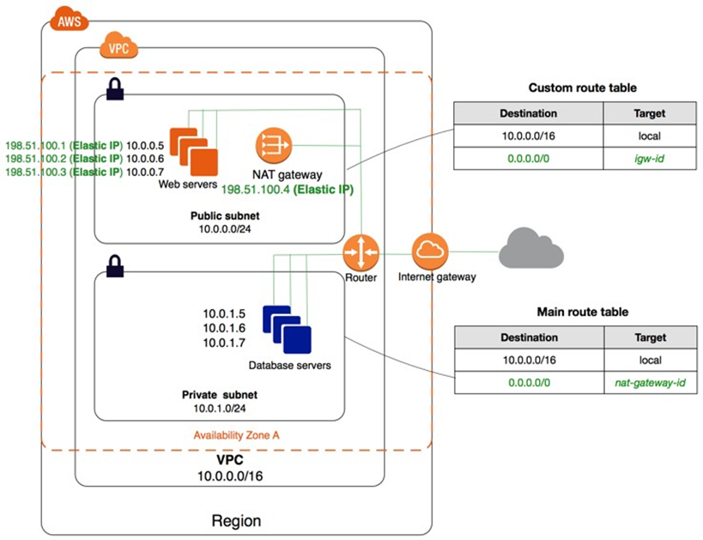
Non-Default VPC

Slide 8
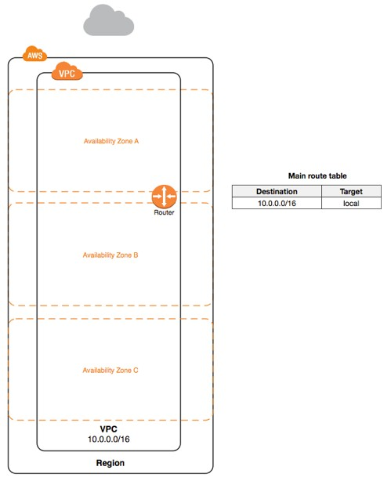
AWS VPC: VPC and Subnet
Specify a range of IP addresses for the VPC in the form of a Classless Inter-Domain Routing (CIDR) block.
Example, 10.0.0.0/16. This is the primary CIDR block for your VPC.
Allowed block size is between a /16 netmask and /28 netmask.
For subnet, specify the CIDR block for the subnet, which is a subset of the VPC CIDR block.
Each subnet must reside entirely within one Availability Zone and cannot span zones.
Use http://www.subnet-calculator.com/cidr.php

Slide 9
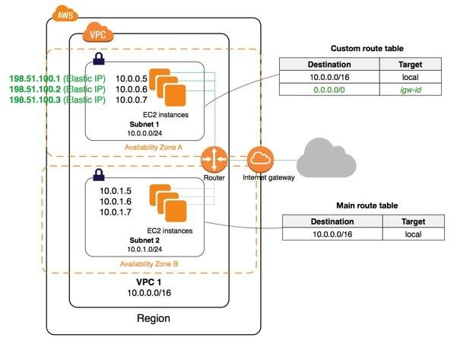
AWS VPC: Public Subnet
16
A public subnet is a subnet that has access to the Internet through an Internet gateway.
Each instance has a private address and public address.
These instances can communicate with each other, and access the Internet.

Slide 10
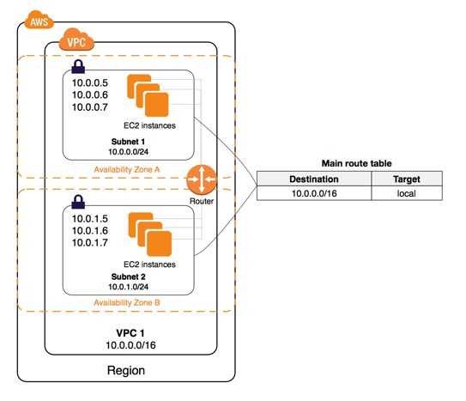
AWS VPC: Private Subnet
If a subnet doesn't have a route to the internet gateway, the subnet is known as a private subnet.
By default, each instance has a private address, but no public address.
These instances can communicate with each other, but can't access the Internet.

Slide 11
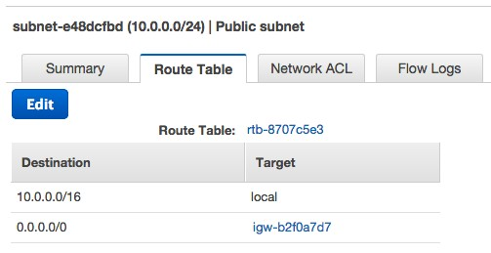
Route Tables
9
A route table contains a set of rules, called routes, that are used to determine where network traffic is directed.
Each subnet in your VPC must be associated with a route table
The table controls the routing for the subnet.
A subnet can only be associated with one route table at a time, but you can associate multiple subnets with the same route table.

Slide 12
Internet Gateway
10
An Internet gateway is a horizontally scaled, redundant, and highly available VPC component that allows communication between instances in your VPC and the Internet.
Uses:
Provides a target in your VPC route tables for Internet-routable traffic
Performs network address translation (NAT) for instances that have been assigned public IPv4 addresses.
An Internet gateway supports IPv4 and IPv6 traffic.

Slide 13

NAT Device
12
NAT device helps to enable instances in a private subnet to connect to the Internet (for example, for software updates) or other AWS services, but prevent the Internet from initiating connections with the instances.
A NAT device forwards traffic from the instances in the private subnet to the Internet or other AWS services, and then sends the response back to the instances.

Slide 14
NAT G/W & NAT Instance
Attribute | NAT Gateway | NAT Instance
Availability | Highly available. NAT gateways in each Availability Zone are implemented with redundancy. Create a NAT gateway in each Availability Zone to ensure zone- independent architecture. | Use a script to manage failover between instances.
Bandwidth | Supports bursts of up to 10Gbps. | Depends on the bandwidth of the instance type.
Maintenance | Managed by AWS.You do not need to perform any maintenance. | Managed by you, for example, by installing software updates or operating system patches on the instance.
Performance | Software is optimized for handling NAT traffic. | A generic Amazon Linux AMI that's configured to perform NAT.
Cost | Charged depending on the number of NAT gateways you use, duration of usage, and amount of data that you send through the NAT gateways. | Charged depending on the number of NAT instances that you use, duration of usage, and instance type and size.
Type and size | Uniform offering; you don’t need to decide on the type or size. | Choose a suitable instance type and size, according to your predicted workload.

Slide 15
Private, Dynamic Public and Elastic IP address
11
A private IPv4 address is an IP address that's not reachable over the Internet. Private IPv4 addresses are used for communication between instances in the same network
A public IP address is an IPv4 address that's reachable from the Internet. Public addresses for communication between your instances and the Internet. Types are Dynamic and Static.
An Elastic IP address is a static public IPv4 address that could be allocate to AWS account. It could be associated to and from instances as required, and it's allocated to the account until you choose to release it

Slide 16
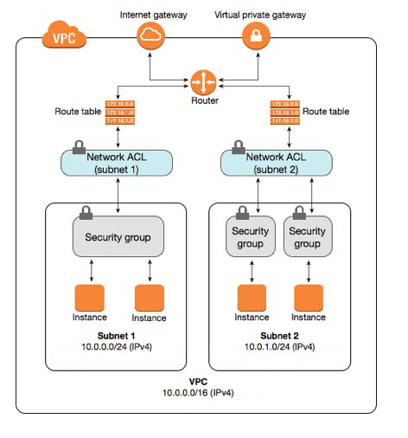
AWS VPC: Security
VPC provides features to increase and monitor the security for your VPC:
Security Groups
Network Access Control Lists (ACLs)
Flow Logs
Security Group | Network ACL
Operates at the instance level (ﬁrst layer of defense) | Operates at the subnet level (second layer of defense)
Supports allow rules only | Supports allow rules and deny rules
Is stateful | Is stateless
Evaluate all rules before deciding whether to allow traﬃc | Process rules in number order when deciding whether to allow traﬃc

Slide 17
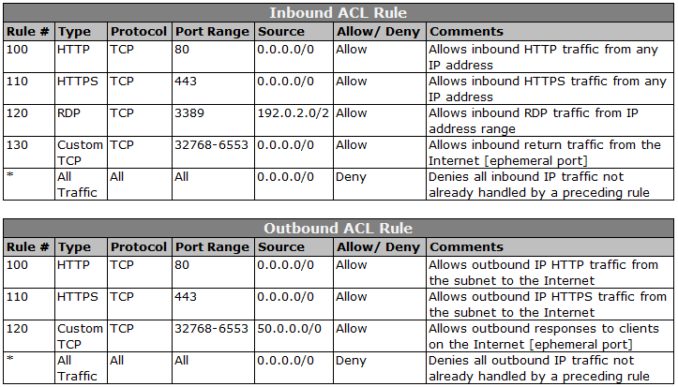
AWS VPC: ACL Rules

Slide 18
AWS VPC: Flow Logs
VPC Flow Logs enables you to capture information about the IP traffic going to and from network interfaces in your VPC.
Flow log data is stored using Amazon CloudWatch Logs.
After you've created a ﬂow log, you can view and retrieve its data in Amazon CloudWatch Logs.
You can create a ﬂow log for:
VPC
Subnet
Network Interface
Flow log format:
version account-id interface-id srcaddr dstaddr srcport dstport protocol packets bytes start end action log- status

Slide 19
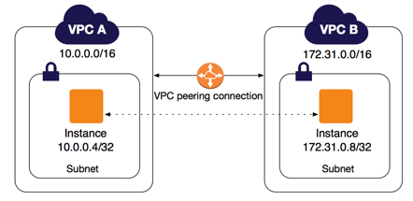
AWS VPC: Peering
VPC peering is a networking connection between two VPCs that enables you to route traffic between them.
Instances in either VPC can communicate with each other as if they are within the same network.
Create a VPC peering connection between own VPCs, or with a VPC in another AWS account.
VPCs can also be in other region.

Slide 20
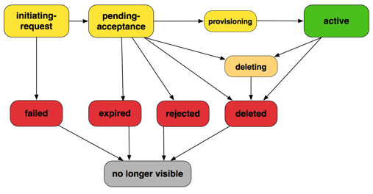
VPC Peering Connection Lifecycle

Slide 21
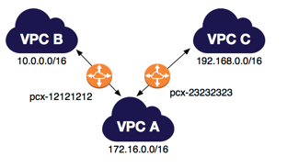
VPC Peering Limitations
A VPC peering connection is a one to one relationship between two VPCs.
One cannot create a VPC peering connection between VPCs that have matching or overlapping IPv4 or IPv6 CIDR blocks.
There is a quota on the number of active and pending VPC peering connections that you can have per VPC.
VPC peering does not support transitive peering relationships. In a VPC peering connection, your VPC does not have access to any other VPCs with which the peer VPC may be peered.
You cannot have more than one VPC peering connection between the same two VPCs at the same time.

Slide 22
Quiz
1. You have created a VPC with the CIDR block 10.0.0.0/16 and have created a public subnet and a private subnet, 10.0.0.0/24 and 10.0.1.0/24, respectively, within it. Which entries should be present in the main route table to allow the instances in VPC to communicate with each other?
Destination: 10.0.0.0/24 and Target VPC
Destination: 10.0.0.0/16 and Target ALL
Destination: 10.0.0.0/0 and Target ALL
Destination: 10.0.0.0/16 and Target Local
2. You have been tasked with auditing the security of your VPC. As part of this process, you need to start by analyzing what trafﬁc is allowed to and from various EC2 instances. What two parts of the VPC do you need to check to accomplish this task?
NACLs and Subnets
Security Groups and Internet Gateways
NACLs and Route Tables
Security Groups and NACLs

Slide 23
Quiz
3.You have provisioned several EC2 instances into private subnets; however, you now have the problem of not being able to download any new software packages or updates. Which of the following provides the best solution?
Create a bastion host in a public subnet to allow the instance in the private subnets with route to the internet.
Create a NAT Gateway in a private subnet, then create a route to it in the route table associated with the private subnets.
Change the associated route table of the private subnets to a route table with a route to an IGW, thus making the subnets public.
Create a NAT Gateway in a public subnet and create a route to it in the route table associated with the private subnets.
4.You want to connect your on-premise data center to AWS using VPN. What things do you need to initiate a VPN connection?
Internet gateway
AWS Direct Connect
Customer gateway & AWS Direct Connect
Customer gateway & Virtual private gateway

Slide 24
Thank You

